Slide 1

Study Contract PTA 2024/2025
Introduction to Data Mining
Taufik Edy Sutanto, MSc.Tech, PhD
Mathematics Department
Faculty of Science & Technology
UIN Syarif Hidayatullah Jakarta

Slide 2
General Information
Course Name | Introduction to Data Mining (Pengantar Penambangan Data)
Course ID | FST6094304
Number of credits | 3
Course Category | Compulsory
Semester | 5
Prerequisites | Analysis Multivariate,Computing Statistics
Language of instruction | English (DS-01), Indonesian (DS-02)
Github | https://s.id/64ukz
LMS | https://lms.uinjakarta.id/course/view.php?id=22
WAG | https://s.id/qoV2j

Slide 3








About the Lecturer(s)
Specialization:
Data Science, Social Media Analytics, AI, Big Data, HPC.
Current Position:
Founder: taudata Analytics™ (Indonesia) – PT Taudata Media Teknologi
Lecturer: UIN Syarif Hidayatullah Jakarta
Head of Mathematics Department
Education:
Khalifa University (Postdoctoral – Data Driven Dynamical Systems) – 2022
Queensland University of Technology (PhD – Data Science for Big Data) - 2017
Tohoku University (Research Program, Machine Learning) - 2007
University of New South Wales (MScTech – Applied Math/Data Mining) - 2005
University of Indonesia (SSi – Mathematics/Computational Statistics) - 2001
Awards:
One of the best researcher KemenAg - 2019
QUT Write-Up Award - 2017
Australian Leadership Award - 2013
Outstanding Awards PDT ADS - 2012 MonbuKagaKusho – 2007
Junior Achievement International – 2002
Contact: taufik@taudata-analytics.com
taufik.sutanto@uinjkt.ac.id https://s.id/taufik-sutanto

Slide 4
Learning methods
Flipped Class
Blended Learning
Use Learning Management System (LMS)
Media synchronous: Microsoft Teams/Google meet/Zoom

Slide 5
Course Description
Data mining focuses on the data processing process starting from data understanding (domain knowledge/business understanding), hypothesis formulation, preprocessing, modeling, evaluation, interpretation, to recommendations for taking action. Data mining uses statistical models or algorithms in machine learning as a tool to achieve this. The entire process above is carried out iteratively and dynamically and is a distinctive feature that distinguishes data mining from other related disciplines.
Some data mining discussions in this lecture include (standard) processes in data mining, analysis of transaction data (association rules), exploratory models, predictive models, to advanced topics such as imbalance learning, and social media analysis.

Slide 6
Course Learning Outcomes
After completing this course, students is able to identify information and insight Which hidden in data use, various method statistics and machine learning and provide (non-trivial) recommendations that users can act on.

Slide 7
Sub Course Learning Outcomes
able to identify and explain real-world problems that can be solved using methods data mining(C2)
able to dodata mining processwith use standard standard Which has There is. (C3)
able to explain the scheme preprocessing,transformation,summary statistics base, Andvisualizationdatabased on the given case. (C2)
Capable to explain procedure and produce information valuable from transactional data as on data sale. (C3)
able to do analysis on unsupervised and also supervised data with optimal use of various method of grouping and compare a number of these methods. (C4)
Capable of applying ensemble model to produce better classification models (C4)
Capable to handle imbalance learning problem (C4)
Capable to apply various tools, methods, and algorithms on social media data (C4)

Slide 8
General requirements
One credit in the form of lecture, response and tutorial learning is 170 minutes, includes:
a
Learning activities with 60 minute structured assignment per week per semester
b
Learning activities with 50 minutes face to faceper week per semester
c
Activity 60 minutes self study per week per semester

Slide 9
Evaluation of Learning Outcomes
“In the event that a student retakes a course, course grades is based on last grade which is obtained."

Slide 10
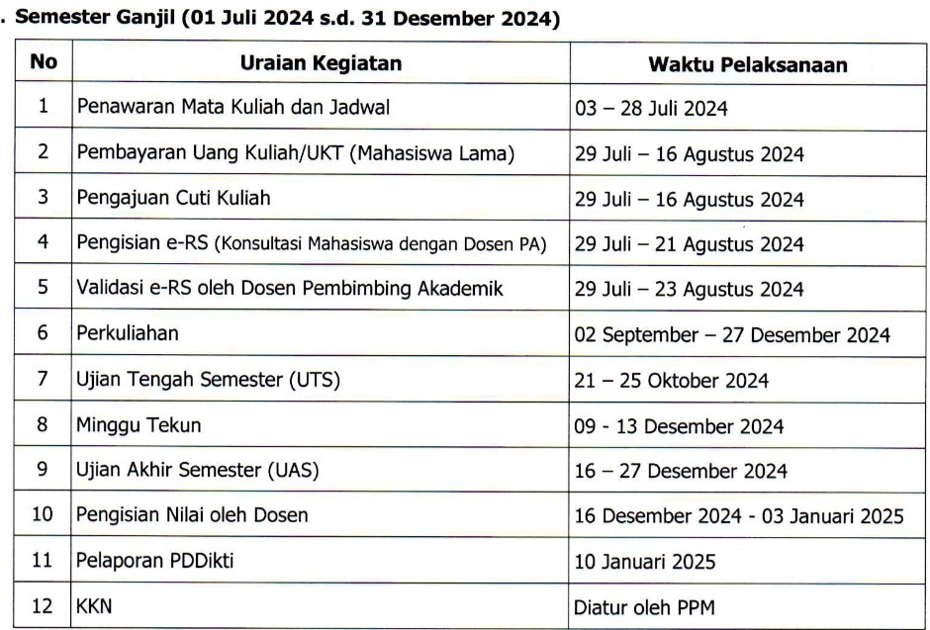
UIN Jakarta Academic Calendar
Odd Semester 2024/2025
Access Academic Guideline:
http://sop.uinjakarta.id

Slide 11
Lecture Program Unit
Week |  | Discussion Topics
1 |  | Contract study , Introduction to data mining
2 |  | Data Mining Process, Data Types, DS Algorithms
3 |  | Exploratory Data Analysis in data mining
4 |  | Case Study – 01: EDA
5 |  | Introduction to Clustering Analysis
6 |  | Clustering Analysis Advanced
7 |  | Association Rules
8 |  | Case Study - 02: Clustering Analysis & Association Rule
9 |  | Capstone Project – 01: 20%

Slide 12
Lecture Program Unit
Week |  | Topics Discussion
10 |  | Correlation and Regression
11 |  | Case Study – 03: Correlation and Regression
12 |  | Classification Model Part – 01
13 |  | Classification Model Part – 02
14 |  | Case Study – 03: Classification Models
15 |  | Natural Language Processing and Text Mining
16 |  | Introduction to Social Media Analytics
17 |  | Case Study – 04: Social Media and Network Analysis
18 |  | Capstone Project – 02 (30%)
Uploading of Values ​​to SIAK-NG: January 10, 2021 at 16.00

Slide 13
Rule FlipClass
Grouped 4-5 Student/Group (Randomized using LMS)
Different members each case study/project.
Case study done in class and submitted on the same day
Computers fully charged, mobile data as a backup
Use Github Link as submission in the LMS
Not allowed to edit after the due date/time.
Code must be able to verify by the lecture by performing “run all” action.

Slide 14
LanguageProgramming
[1]. Python (version 3.10) following the Google Colaboratory version
Computational Platform:
[3]. GitHub:https://desktop.github.com/
[4]. GoogleCollaborative:https://colab.research.google.com/
[5]. Module: Numpy, Pandas, Scikit-learn, statisticsmodels, networkX.

Slide 15
Assessment Components
Component | Weight (%)
Capstone Project 01 | 20
Capstone Project 02 | 30
Case Study* (5X) | 50
Total | 100

Slide 16
Reading and Reference Materials
Data Mining: Concepts and Techniques by J Han, MKamber& J Pei, 2012, 3rd edition, Morgan Kaufmann.
Aggarwal, C. C. (2015). Data mining: the textbook. Springer.
P. Cabena, P.Hadjinian, R. Stadler, J.Verhees, You.Zanasi. Discovering Data Mining: From Concept to Implementation. IBM, 1997
U. Fayyad, G.Piatetsky-Shapiro, and P. Smith. From data mining to knowledge discovery. A.IMagazine, Volume17, pages 37-54, 1996.
Barry, AJ Michael &Linoff, S. Gordon. 2004. Data Mining Techniques. Wiley Publishing, Inc. Indianapolis : xxiii + 615p..
Malik, U., Goldwasser, M., & Johnston, B. (2019). SQL for Data Analytics: Perform fast and efficient data analysis with the power of SQL.PacketPublishing Ltd.

Slide 17
Lecture Rules and Regulations
01
Students are compulsory to be registered in AIS/eSemesta
02
Student must ensure their assigned class
03
Students must pay attention lecture schedule (offline / online, synchronous / asynchronous)
04
LMS UIN Jakarta is a platform used for interaction between lecturers/teaching teams and students, so students must always pay attention to announcements on the LMS.
05
In addition to in-class lectures, other media such as email, SMS, Whatsapp, LMS can be used according to agreement with the lecturer/teaching team.
06
Students are required pay attention to ethics if you want to contact the lecturer/teaching team (during working days and hours).

Slide 18
Ethical Use of AI
01
AI as Learning Assistant
02
AI to paraphrase complete texts
03
Generate basic codes
04
Not used during exams in which the use of AI is not explicitly allowed.

